Slide 1
Review-1 on EmoJam: Mood-aware Music Recommendation System with Facial Recognition
Eppali Pravallika - 2010030046
Tahseen Begum - 2010030168
Rushitha Sri - 2010030362
K.Kavya - 2010030550
Under the Guidance of
Dr. N. Chiranjeevi
Professor
Computer Science and Engineering Department
KL Hyderabad Off Campus, Aziz Nagar , Hyderabad

Slide 2
Overview
Introduction
Literature Review
Problem Statement
Objectives of the Project
Proposed Algorithm
References

Slide 3
Introduction
EmoJam is an innovative mood-aware music recommendation system that utilizes facial recognition technology to personalize music choices.
Experience EmoJam's synergy of facial recognition and mood-based music curation, revolutionizing how we connect with music on an emotional level.
By analyzing users’ facial expressions, EmoJam accurately determines their emotional states and suggests music that aligns with their feelings.
This real-time approach enhances user experience, providing seamless access to suitable tracks that cater to their current moods.
EmoJam bridges the gap between emotions and music, creating a dynamic and engaging musical journey.

Slide 4
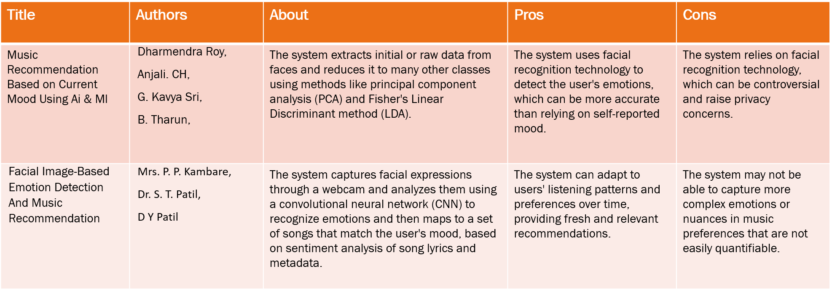
Literature Review

Slide 5
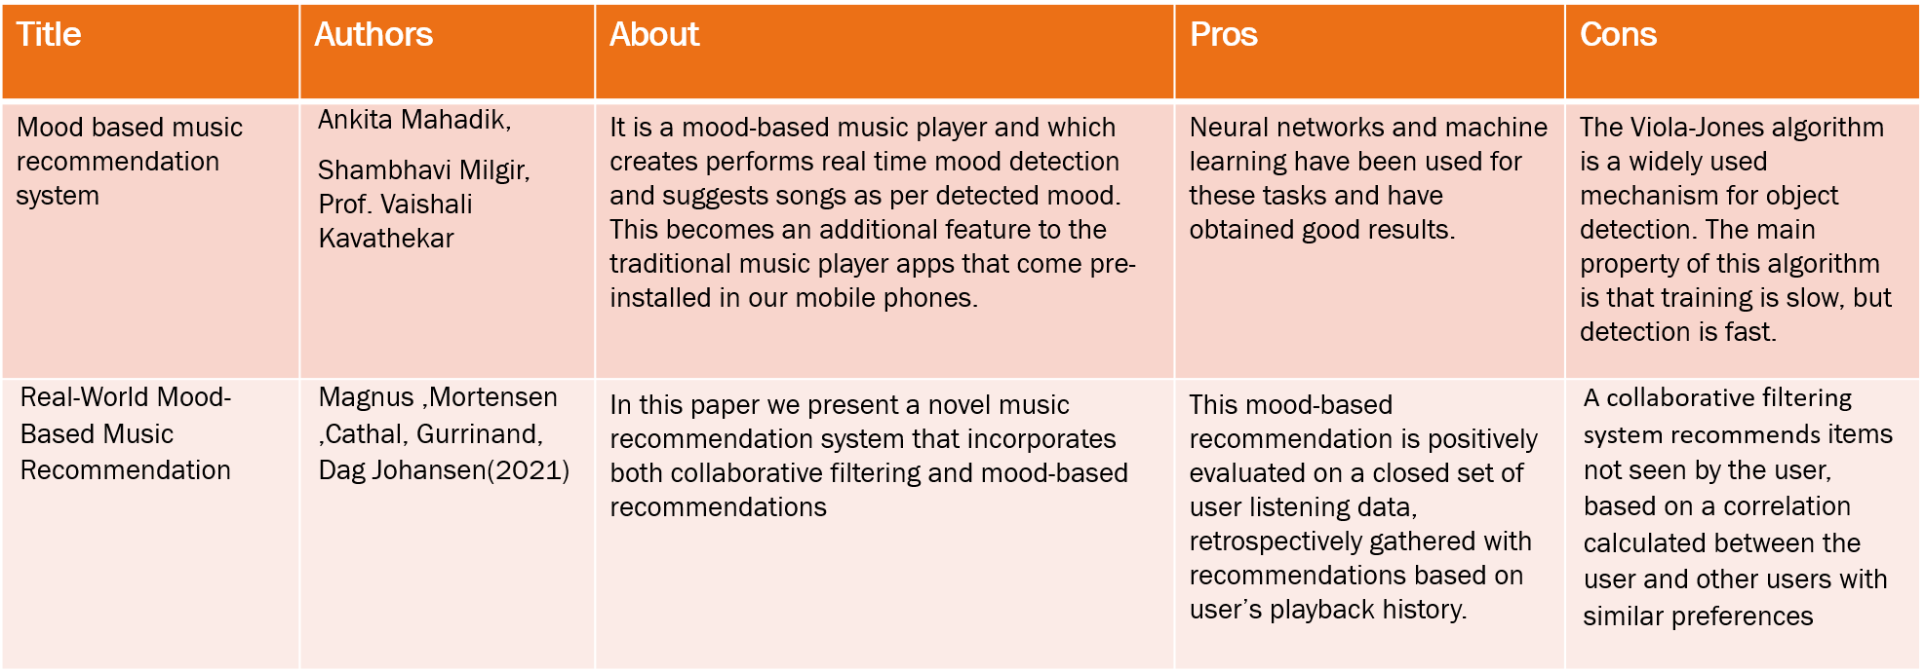
Literature Review

Slide 6
Problem Statement
"EmoJam" is an innovative project focused on developing a mood-aware music recommendation system that employs facial recognition technology. This system will analyze users' facial expressions in real-time to determine their emotional states and preferences. By combining facial data with mood-specific music databases, EmoJam will deliver personalized music recommendations that align with users' emotions, enhancing their listening experience and fostering emotional well-being.

Slide 7
Objectives of the Project
Objective 1: Mood-aware Music Recommendation
The EmoJam project aims to build an innovative music recommendation system that accurately interprets users' moods through inputs like facial expressions and actions. By suggesting music aligned with their emotions, the system enhances music discovery and fosters emotional connections through music.
Objective 2: Facial Recognition Integration
The EmoJam project integrates facial recognition to interpret real-time emotional expressions, enabling personalized music recommendations based on users' captured cues. This enhances the interactive experience, fostering emotional connection through accurate facial analysis for responsive music suggestions.

Slide 8
Proposed Algorithm
1. The Vector Support Machine (SVM) algorithm is a machine learning used for emotion detection. It works by finding a hyperplane in a high-dimensional space that best separates different emotions based on input features.
2. MediaPipe is a framework developed by Google that enables the building of applications involving perceptual computing tasks, such as gesture recognition, facial detection, and pose estimation, using machine learning models. When combined with an Artificial Neural Network (ANN) algorithm for music suggestion, MediaPipe can analyze user gestures or facial expressions as input, process them using the ANN, and recommend music based on the detected emotional or contextual cues.

Slide 9
References
https://www.researchsquare.com/article/rs-2719247/v1
http://www.journal-iiie-india.com/1_june_23/19.3_6.pdf
https://www.researchgate.net/publication/352780489_Mood_based_music_recommendation_system
https://www.researchgate.net/publication/221055652_Real-World_Mood-Based_Music_Recommendation

Slide 10
Thank you and Any Queries

